Slide 1
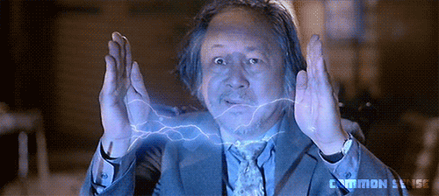
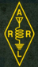
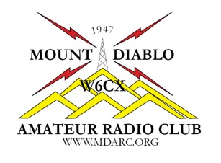
Chapter 9
Safety
Name, Callsign
Discussion Leader
American Radio Relay League

Slide 2
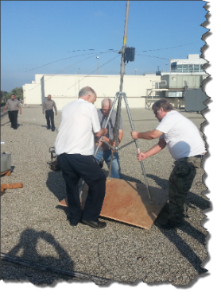
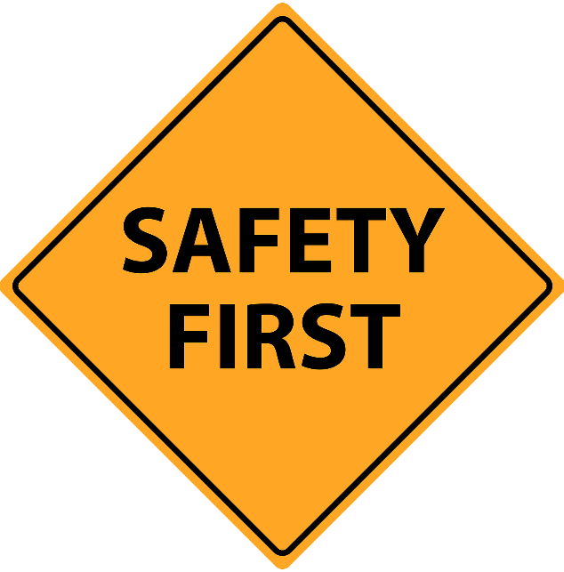

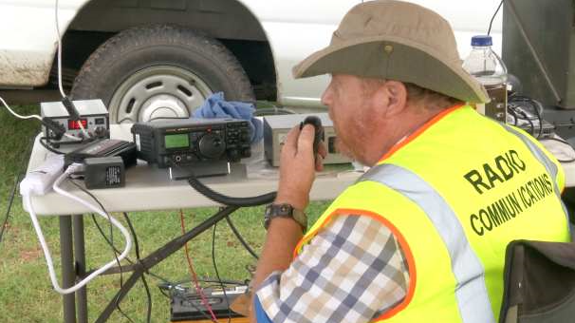
Chapter 9 Safety
In the previous session we looked at all sorts of amateur radio equipment and the many ways these can be used to communicate around the world or just down the street.
In this session we look at how we safely operate this equipment for ourselves and those around us.
2019 MDARC Technician License Course

Slide 3
Chapter 9 9.1 Electrical Safety
Contact with energized circuits can result in shocks and burns.
The severity of the injury varies depending on the voltage and current present.
Relatively high voltage (greater than 30v) has to be present to get through the high resistance of the skin.
Once current starts flowing, everything depends on HOW MUCH CURRENT there is.
The three main ways electrical injury occurs:
heating tissue
electrical disruption of cell function (nervous system)
involuntary muscle contractions
3
2019 MDARC Technician License Course

Slide 4
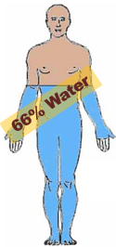
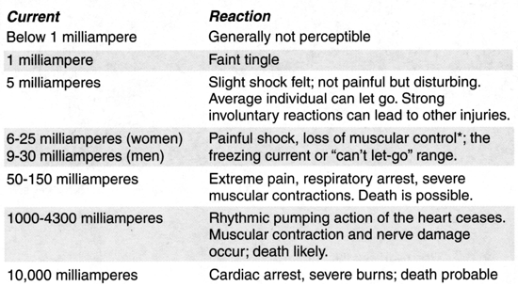
Chapter 9 9.1 Electrical Safety
Effects of Electric Current in the Human Body
Table 9.1
4
2019 MDARC Technician License Course

Slide 5
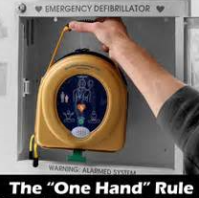
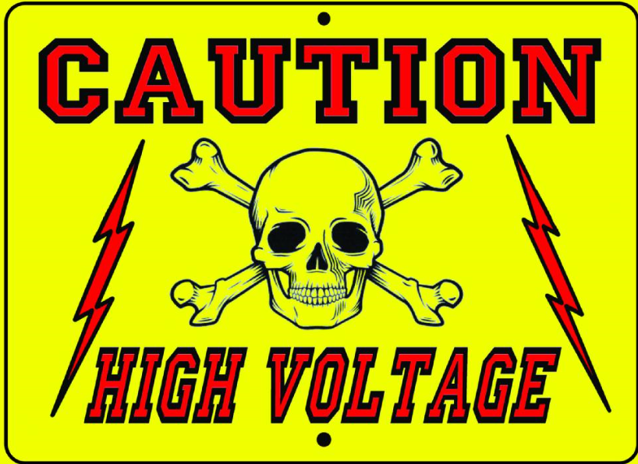
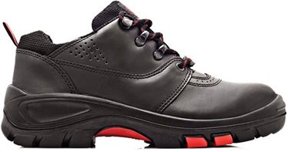
Chapter 9 9.1 Electrical Safety
Avoiding Electrical Hazards
Never work on energized equipment if you can avoid it.
But if you must, take these precautions:
Keep one hand in pocket and wear non-conducting shoes.
Be extra careful around high voltage.
Never bypass safety interlocks
5
2019 MDARC Technician License Course

Slide 6
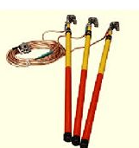
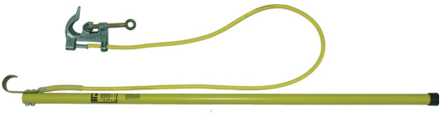
Chapter 9 9.1 Electrical Safety
Avoiding Electrical Hazards
More precautions……….
Be aware of stored charges in capacitors.
They can carry a lethal electric charge long after the power is off.
Use a grounding stick to discharge high voltage capacitors.
Grounding sticks
6
2019 MDARC Technician License Course

Slide 7
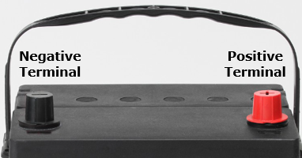
Chapter 9 9.1 Electrical Safety
Avoiding Electrical Hazards
More precautions……….
Storage batteries may be only 12 volts, but can deliver hundreds of amperes, causing burns, fires and even explosions.
Avoid shorting the battery with a tool.
If possible, disconnect the battery before working on equipment.
7
2019 MDARC Technician License Course

Slide 8
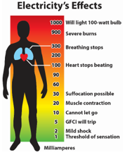
Chapter 9 9.1 Electrical Safety
Avoiding Electrical Hazards
More precautions……….
Take off rings and watches.
Don’t work alone.
Remember that electricity is faster than you are.
Even a fleeting brush can mean death.
8
2019 MDARC Technician License Course

Slide 9
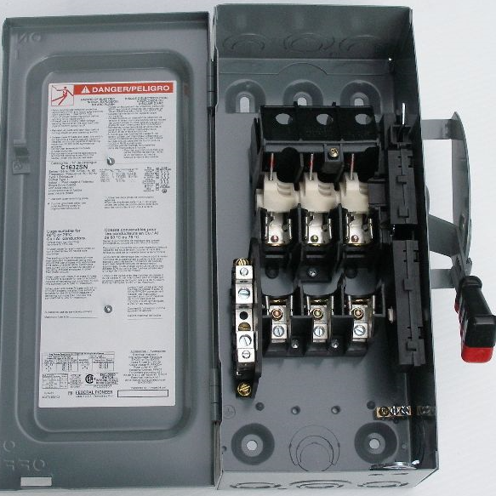
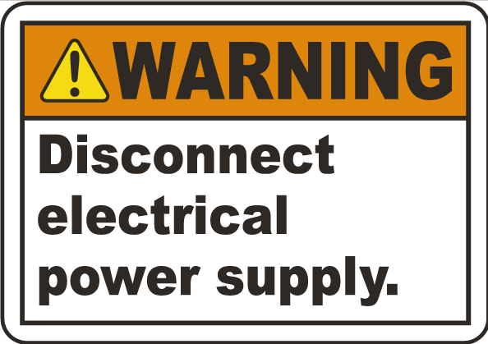
Chapter 9 9.1 Electrical Safety
Response to Electrical Injury
Remove power from the scene. FIRST!
Use an easily accessible master switch for all power to your station.
Show your family how to turn it off.
Learn CPR.
Consult WebMD for first aid advice on “electric shock.”
9
2019 MDARC Technician License Course

Slide 10
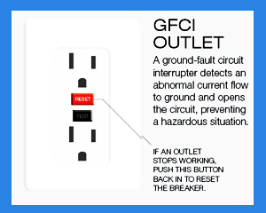
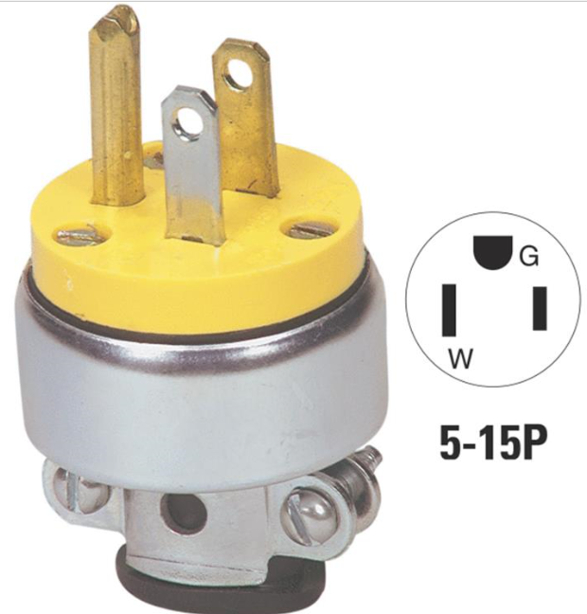
Chapter 9 9.1 Electrical Safety
AC Safety Grounding
Avoid creating shock hazards. Follow the NEC (National Electrical Code).
Use three-wire grounded cords for all equipment
Connect all AC equipment to a common SAFETY GROUND
Protect circuits with GFI (ground fault interrupter) circuit breakers
10
2019 MDARC Technician License Course

Slide 11
Chapter 9 9.1 Electrical Safety
AC Safety Grounding
Verify circuits with an AC circuit tester.
Never replace a fuse or circuit breaker with one of larger size.
Do not overload single outlets (avoid power strips if possible).
If you do use a power strip, be sure the combined loads are under the rated capacity for the wall outlet and the strip.
11
2019 MDARC Technician License Course

Slide 12
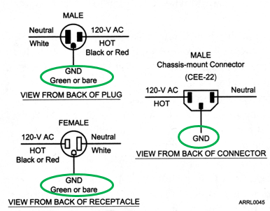
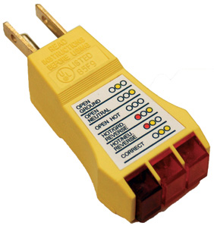
Chapter 9 Electrical Safety
AC Safety Grounding
AC Circuit Tester
GREEN = SAFETY GROUND
Figure 9.1, Page 9-4
12
2019 MDARC Technician License Course

Slide 13
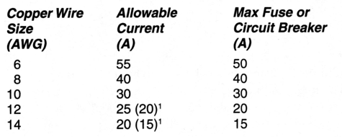
Chapter 9 9.1 Electrical Safety
AC Safety Grounding
Current-Carrying Capability of Some Common Wire Sizes
Table 9.2
Footnote 1: see textbook for National Electrical Code requirements
Use wire large enough to carry the current.
When you build your own equipment, include a fuse or circuit breaker.
13
2019 MDARC Technician License Course

Slide 14
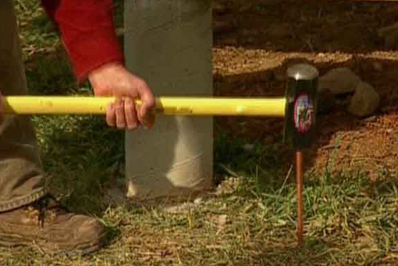
Chapter 9 9.1 Electrical Safety
AC Safety Grounding
RF Burns
High voltage RF can cause burns if touched.
Special RF grounding may be necessary to prevent RF “hot spots” in your station.
Bond the metal frames of all equipment to copper strapping and connect to an exterior GROUND ROD.
14
2019 MDARC Technician License Course

Slide 15
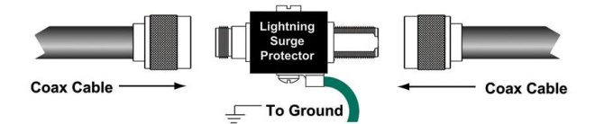
Chapter 9 9.1 Electrical Safety
AC Safety Grounding
Lightning
Ground all towers, masts, and antenna mounts according to LOCAL ELECTRIC CODES.
Best practices for lightning ground systems……….
Avoid sharp bends.
Keep conductors as short and direct as possible.
Lightning arrestors must be connected to a common plate, which is in turn bonded to an external ground.
15
2019 MDARC Technician License Course

Slide 16
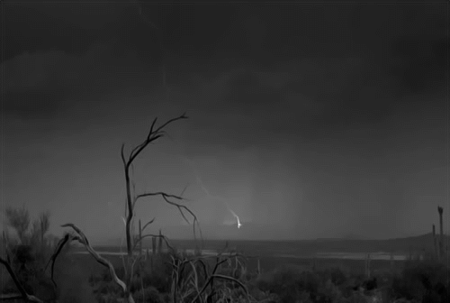
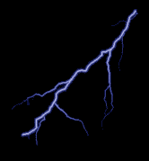
Chapter 9 9.1 Electrical Safety
AC Safety Grounding
Lightning
When thunderstorms are predicted, disconnect power, phone lines, and external antenna feed lines.
Check your insurance coverage for lightning damage.
NEVER operate your station during a thunderstorm.
You could permanently become “one with nature.”
16
2019 MDARC Technician License Course

Slide 17
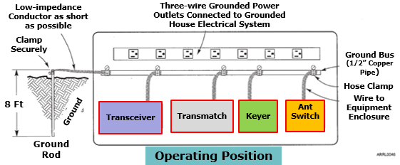
Chapter 9 9.2 Managing RF in your Station
Important step for your equipment set up
Follow safety practices for AC electrical grounding
Adapted from Figure 9.2
2019 MDARC Technician License Course
17

Slide 18
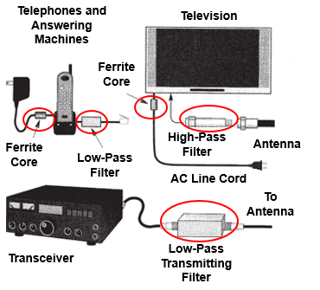
Chapter 9 9.3 RF Interference (RFI)
Remedies
Filters
Play a major part in eliminating or reducing Radio Frequency Interference.
Used both to prevent unwanted signals from being radiated and to keep unwanted signals from being received.
Figure 5.15, Page 5.19
2019 MDARC Technician License Course
18

Slide 19
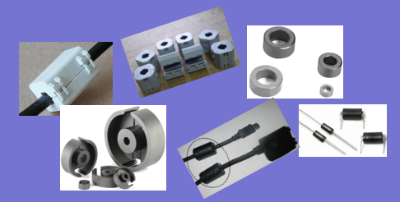
Chapter 9 9.3 RF Interference (RFI)
Remedies
Ferrite Core RFI Filters….aka Choke Filters
Made from a ceramic magnetic material designed to absorb RF energy over a broad frequency range, such as HF and VHF.
They come in many sizes and shapes with many different uses.
Rings (toroid)
Rods
Beads
2019 MDARC Technician License Course
19

Slide 20
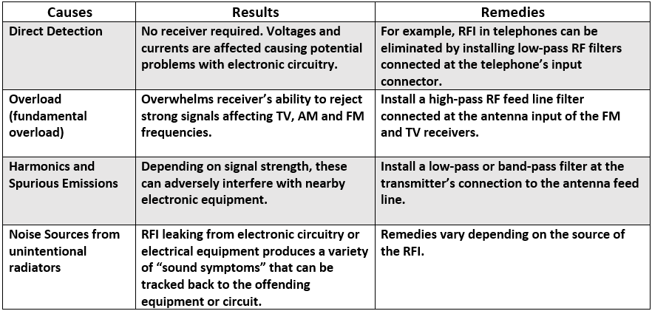
Chapter 5 5.4 RF Interference (RFI)
Radio Frequency Interference can be of several types
2019 MDARC Technician License Course
20

Slide 21
Chapter 9 9.3 RF Interference (RFI)
Guidelines to follow
Be certain your station is in good working order.
Use shielded wire and shielded cables to prevent coupling with unwanted signals and undesired RF radiation.
Eliminate interference to your own appliances.
Eliminate sources of interference coming from electrical equipment in your own house.
2019 MDARC Technician License Course
21

Slide 22
Chapter 9 9.3 RF Interference (RFI)
Guidelines to follow with the neighbors
DIPLOMACY is a key starter!
Verify if the interference is actually coming from your equipment.
Provide assistance to the neighbor to determine the nature of the interference.
Overload
Harmonics
Detection
Offer to help eliminate RFI sources coming from their house.
2019 MDARC Technician License Course
22

Slide 23
Chapter 9 9.3 RF Interference (RFI)
The law is on your side
An unlicensed device permitted under Part 15 or an unintentional radiator may not cause interference to a licensed communications station, such as to an Amateur Radio station. Its owner must prevent it from causing such interference or stop operating it.
An unlicensed device permitted under Part 15 must accept interference caused by a properly operating licensed communication station, such as from an Amateur Radio station.
From Page 5-23, under PART 15 Rules
2019 MDARC Technician License Course
23

Slide 24
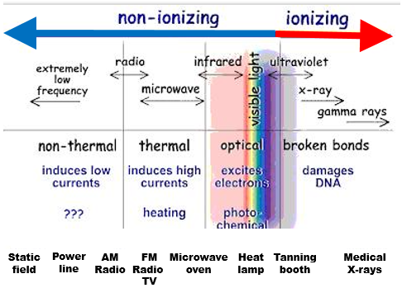
Chapter 9 9.4 RF Exposure
Radiation
Ionizing radiation comes from radioactive sources, x-rays gamma rays, cosmic rays (can cause genetic damage).
RF radiation is non-ionizing. (does not have sufficient energy to cause genetic damage).
24
2019 MDARC Technician License Course

Slide 25
Chapter 9 9.4 RF Exposure
Maximum Permissible Exposure
The FCC has set standards for the MAXIMUM PERMISSIBLE EXPOSURE for radio transmitters of any sort, including amateur radio transmitters.
Thermal effects (heating of tissue) have been demonstrated. Heating only occurs at high radio field intensity when very close to the source.
25
2019 MDARC Technician License Course

Slide 26
Chapter 9 9.4 RF Exposure
Maximum Permissible Exposure
Biological effects of RF exposure have not been demonstrated at amateur radio frequencies and power levels.
Two methods of making sure that persons are not exposed to RF heating……….
Preventing access to RF fields.
Make sure strong RF fields are not created or directed at areas where people may be present.
RF burns can happen if someone touches your antenna while you are transmitting.
26
2019 MDARC Technician License Course

Slide 27
Chapter 9 9.4 RF Exposure
Maximum Permissible Exposure
Exposure limits vary by frequency because the human body will absorb more energy at some frequencies than others.
Power density is measured in MILLIWATTS PER SQUARE CENTIMETER. Power density is greater near antennas or in front of directional antennas.
Power density falls off rapidly with distance from the source. Twice as far has only one quarter the power density.
27
2019 MDARC Technician License Course

Slide 28
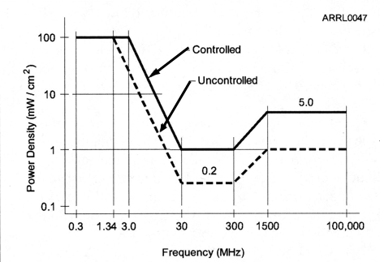
Chapter 9 9.4 RF Exposure
Maximum Permissible Exposure
Note that the lowest permissible limits occur between 30MHz and 300 MHz. For instance, at 50 MHz.
Figure 9.5
28
2019 MDARC Technician License Course

Slide 29
Chapter 9 9.4 RF Exposure
Maximum Permissible Exposure
Controlled and Uncontrolled environments
CONTROLLED ENVIRONMENTS are areas where people who are aware of the RF exposure and can take precautions.
You and your guests in your home will likely be aware, so the higher limits for a controlled environment apply.
UNCONTROLLED ENVIRONMENTS are areas the general public will have access to, and may not be aware of the hazard.
Your neighbor’s back yard is an uncontrolled environment so you will have to evaluate if your antenna is too close to the fence. If so, then the lower limits for an uncontrolled environment would apply.
29
2019 MDARC Technician License Course

Slide 30
Chapter 9 9.4 RF Exposure
Maximum Permissible Exposure
Averaging and duty cycle
MPE limits are based on AVERAGE exposures, not PEAK exposure. RF heating takes place over many seconds. Therefore duty cycle affects the average exposure of people to non-ionizing radiation.
The duty cycle is the PERCENTAGE OF TIME that the transmitter is transmitting. If the duty cycle of a transmitter is only 50%, then the highest power limit for that transmitter can be twice as high.
30
2019 MDARC Technician License Course

Slide 31
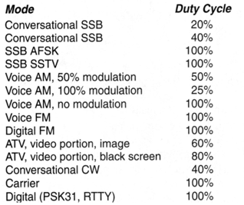
Chapter 9 9.4 RF Exposure
Maximum Permissible Exposure
Operating Duty Cycle of Modes Commonly Used by Amateurs
Different transmitting modes have different duty cycles
Table 9.4, Page 9-8
31
2019 MDARC Technician License Course

Slide 32
Chapter 9 9.4 RF Exposure
Maximum Permissible Exposure
Effects of antenna gain
Beam antennas focus their energy in the forward direction.
They are rated for how directive they are by GAIN, calculated in decibels (dB).
The higher the gain of your antenna, the lower the permissible power level will be for exposure in that direction.
32
2019 MDARC Technician License Course

Slide 33
Chapter 9 9.4 RF Exposure
Maximum Permissible Exposure
Calculating MPE
ALL fixed radio stations must perform exposure evaluations to determine that they are safe.
Three methods may be used………
Calculation based on FCC OET Bulletin 65.
Calculation based on computer modeling.
Direct measurement of field strength.
If you change your equipment or add a frequency band, you are required to re-evaluate your station.
33
2019 MDARC Technician License Course

Slide 34
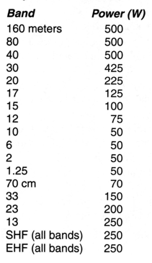
Chapter 9 9.4 RF Exposure
Maximum Permissible Exposure
Power Thresholds for RF Exposure Evaluation
THE GOOD NEWS
The FCC has exempted certain power levels from the evaluation requirement, because the danger is minimal.
For instance you can transmit up to 50 watts on VHF (6m, 2m, 1.25m) without having to do an evaluation.
Table 9.4
34
2019 MDARC Technician License Course

Slide 35
Chapter 9 9.4 RF Exposure
Maximum Permissible Exposure
Hams are allowed to transmit a great deal more power than these exemptions. If the exempt power levels are exceeded, you MUST evaluate for MPE.
Remember that three factors are needed for an RF exposure evaluation………..
Frequency and power level
Distance from the antenna
Radiation pattern of the antenna
35
2019 MDARC Technician License Course

Slide 36
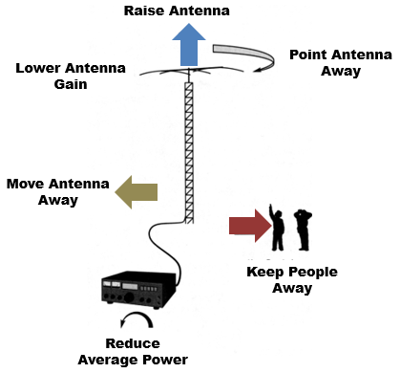
Chapter 9 9.4 RF Exposure
Maximum Permissible Exposure
Limiting RF Exposure
All these methods work to reduce RF exposure.
Be careful of placing antennas too near your property line and move them if necessary.
Figure 9.6
36
2019 MDARC Technician License Course

Slide 37
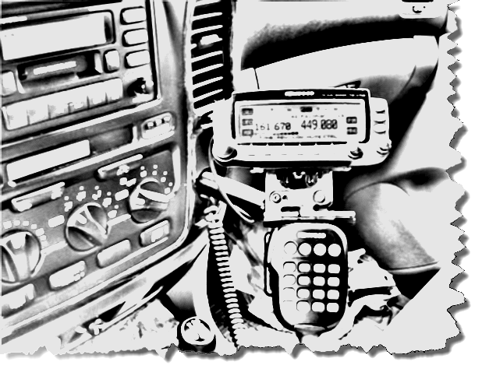
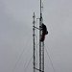
Chapter 9 9.5 Mechanical Safety
Mobile Installations
Secure radio equipment so that it won’t fly about the passenger compartment in an accident.
Do not obstruct your vision or allow it to distract from driving.
Don’t operate in heavy traffic.
Pull over to make complicated adjustments to the radio.
37
2019 MDARC Technician License Course

Slide 38
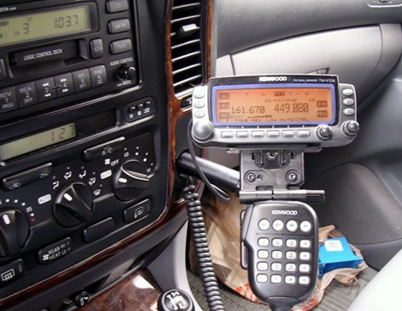
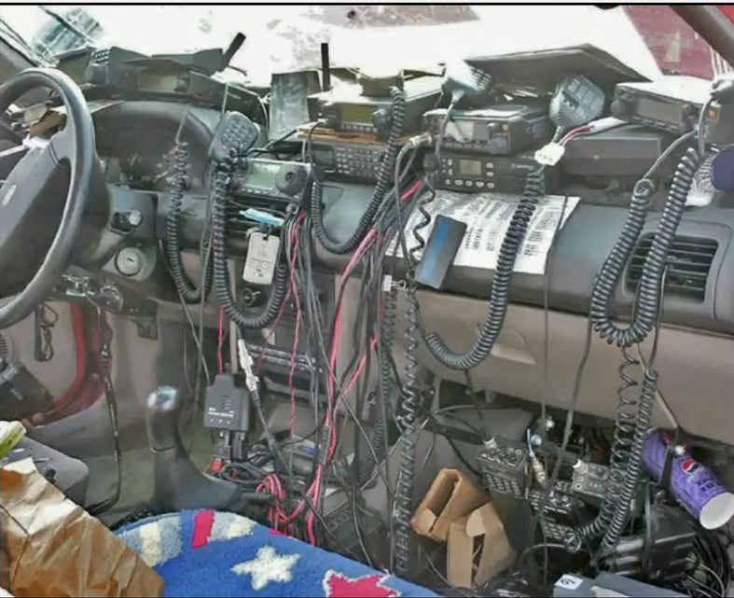
Chapter 9 9.5 Mechanical Safety
Mobile Installations
Like This
Not Like This!
38
2019 MDARC Technician License Course

Slide 39
Chapter 9 9.5 Mechanical Safety
Installing Antennas and Supports
Stay clear of overhead electrical wires.
The minimum safe distance from an electrical line is the height of the mast plus 10 feet.
NEVER attach an antenna to a utility pole. It may come in contact with high voltage power lines.
39
2019 MDARC Technician License Course

Slide 40
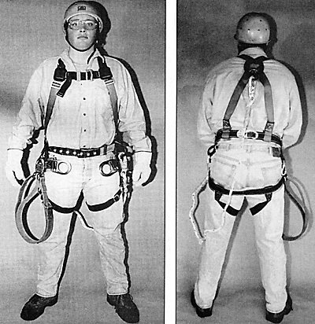
Chapter 9 9.5 Mechanical Safety
Installing Antennas and Supports
Tower Safety
Hard hat and gloves should be worn at all times when working on radio towers.
Use a climbing harness and safety glasses when climbing a tower.
40
2019 MDARC Technician License Course

Slide 41
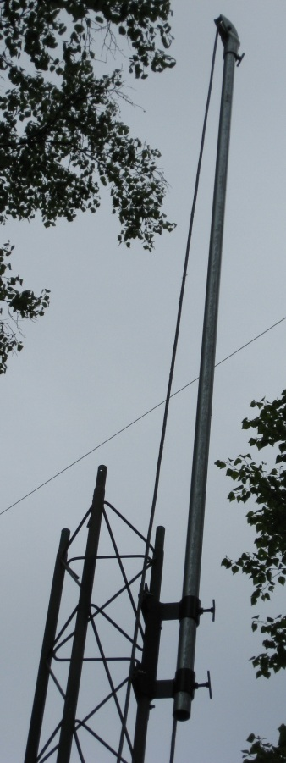
Chapter 9 9.5 Mechanical Safety
Installing Antennas and Supports
Tower Safety
NEVER climb a crank-up tower unless it is fully retracted.
Use a gin pole (temporary clamping mast) to lift tower sections and large antennas into place.
NEVER climb a tower alone, without a helper or observer.
41
2019 MDARC Technician License Course

Slide 42

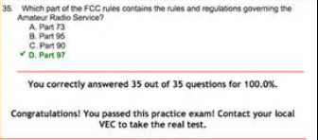
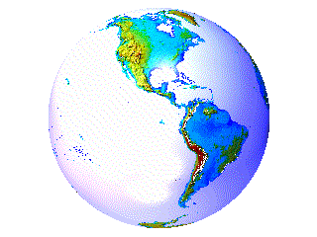
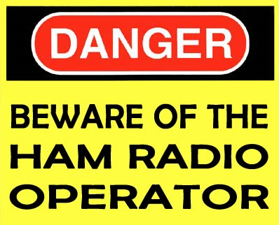
Next Week: License Testing!
Study your STUDY GUIDE in preparation for the Technician Class License Exam next week (March 7, 2019)
The Technician Class License Exam will occur in Luther Hall at Trinity Lutheran Church (your class room).
42
2019 MDARC Technician License Course

Slide 43
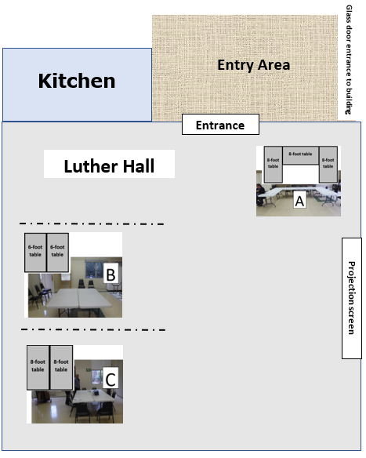
Please follow the Elmers’ directions
2019 MDARC Technician License Course

